Slide 1
NAME: INSTITUTION: INSTRUCTOR: COURSE:

Slide 2
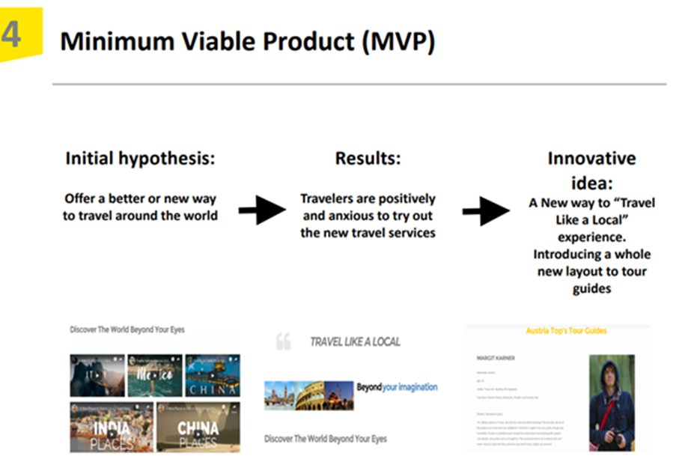
Minimum Viable Product
MVP is involves developing a new product with sufficient features to meet the desires of customers.
The product has enough value. This motivates people to have the willingness to buy the product initially or use it.
The early adopters consider the product to have enough future benefit.
The Minimum Viable Product gives enough feedbacks that guides future developments.
Notes:
The Minimum Viable Product prototype involves the establishment of new products or websites which come with sufficient features and components that aim to satisfy the early adopters or target users (Schuh, Dölle, & Schloesser, 2018). Eric Ries, a writer on startups and a consultant, is known for popularizing this concept and playing a role in developing it.
The product is released into the market. The innovators assess and evaluate how early adopters respond to it. After that, the innovator decided to finalize the product by completing to design and develop a set of features after acquiring the feedback from the product's initial users.
This prototype has three characteristics.
The product has enough value. This motivates people to have the willingness to buy the product initially or use it.
The early adopters consider the product to have enough future benefit.
The Minimum Viable Product gives enough feedbacks that guides future developments.
Considering our MVP, it is evident that the Minimum Viable Product’s developing team will barely waste time on the new product that is still in its development stages (Lenarduzzi, & Taibi, 2016). However, the team can continue developing its features over time after assessing how customers are responding to it, evaluating customers’ preferences and desires while they begin to use the product.
However, in case feedback from intended clients isn’t pleasant, the product is meant to change or even be abandoned. At this point, the developing team is not obliged to invest more resources in the product. This is because the users have proven to dislike it or have no need for it and opt for the original product at the cost of the new one.
The developers are needed to learn more about the product during its development. They can acquire details about it through developing ways to gather information from customers who are already authenticated (Duc & Abrahamsson, 2016). The MVP technique is considered to be viable for technically-oriented products.

Slide 3
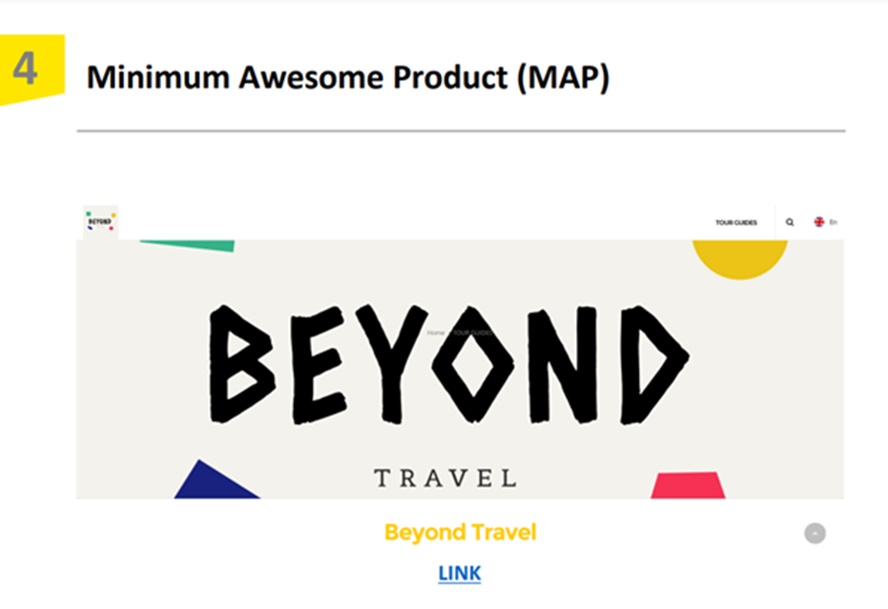
Minimum Awesome Product
The Minimum Awesome Product is a prototype meant to test the product hypothesis.
Minimum Awesome Product is a Minimum Viable Product with an awesome effect.
Minimum Awesome Product is definitely beyond just producing and releasing a product to the market.
Notes:
The Minimum Awesome Product is a prototype meant to test the product hypothesis. Normally, a Minimum Awesome Product is a Minimum Viable Product with an awesome effect (Olsen, 2015). It is considered as a product made with minimum functionalities but produces great components that customers can't resist.
Minimum Awesome Product is definitely beyond just producing and releasing a product to the market, basically with enough user-friendliness (Erickson, 2015). On the other hand, it attempts to provide more comfort than ordinary customers expect.
The Minimum Awesome Product goes through the following procedure;
When developing the MAP from scratch:
First, know your audience. Know the needs of the business and customers by carrying out a variety of analyses on value client's preferences and needs. Conduct an investigation on the market to understand whether there is a similar product already in existence (Erickson, 2015). Then know your competitors and closely watch out for them.
Second, come up with an idea. At this point, you need to address questions like, what goal do you have? Will the idea create a better future for your customers? How will your potential customers access your Minimum Awesome Product? What will be the product’s cost?
Third, select your design process and user flow. You should consider developing a convenient and reliable app interface and design processes. Analyze your customers' perspective, and this will help in developing an appropriate design method (Olsen, 2015).
Fourth, note all realistic features that have the potential of drawing customers and providing them with an awesome user experience. Prioritize and categorize the features considering the needs of the users.
The fifth and the last is the action step. You reach this step after completing the research, answering the questions, templates, and designs (Olsen, 2015). Here, you can develop your Minimum Awesome Product app for the business.

Slide 4
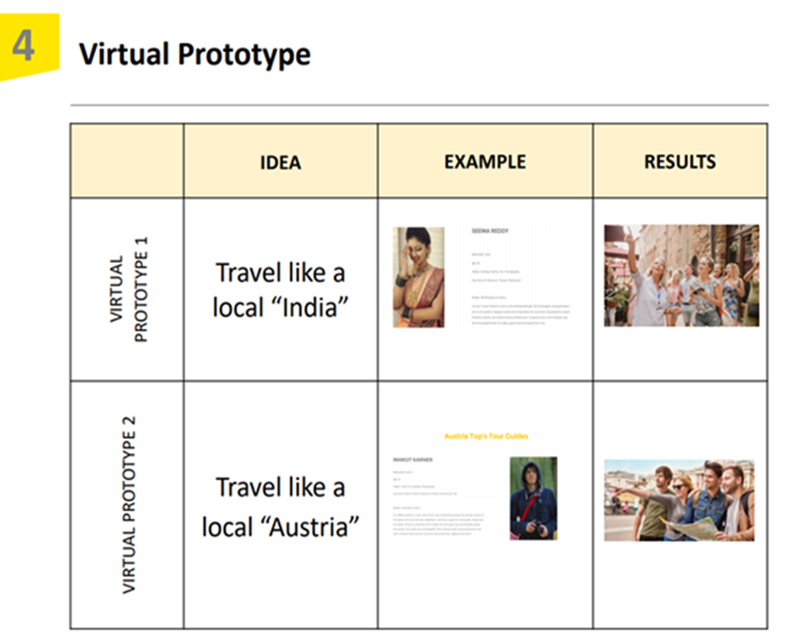
Virtual prototype
Virtual prototyping is a technique applied while developing a product.
use of computer-aided design and computer-aided engineering software.
VP allows the building and testing of virtual prototypes.
Notes:
Virtual prototyping is a technique applied while developing a product. It involves the use of computer-aided design and computer-aided engineering software as a way to authenticate a design before it is committed to making a physical prototype (Allmacher et al., 2018). Everything here is managed through computer-generated geometrical parts.
A virtual prototype is recently used as a substitute for the rapid prototype. The virtual prototype doesn't give a physical object that might be assessed, evaluated, and tested. As the name suggests, everything is done within a computer. This is a technology the industries are embracing in their today's operations.
VP allows the building and testing of virtual prototypes. Afterward, the engineering team can realistically simulate the parts of the virtual prototypes on the computers mathematically and visually (Allmacher et al., 2018). This makes it easy and possible for the team to analyze the full-motion behaviors of the complicated mechanical systems before developing and establishing a real hardware prototype.
At this point, the users have a chance to quickly explore the various developed designs, test and refine them till the systems’ performances are optimized (Leino, 2015). With this, there is a reduction of time and cost of developing a new product and helps to improve the quality of the system’s designs.
The virtual prototype technology basically operates towards meeting the computer-aided engineering (CAE) goals. These goals include minimizing time and cost and at the same time maximizing the quality and efficiency of the product to be produced. However, when physically making a prototype, the technology doesn't need any form of hardware, like in the case of rapid prototyping (Nam et al., 2019). For that reason, it involves less cost incurred in the process.
It is important to note that virtual prototypes can be applied in testing things from their component parts to their entire whole without bothering to build a comparatively costly physical prototype.

Slide 5
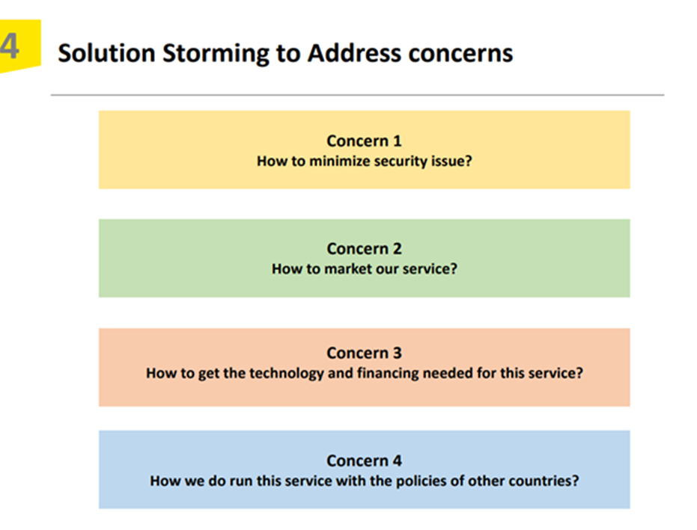
Solution Process Template
Solution process or PAINstorming is a tool that uses a well-structured method used to give a focus, direction, insight, and data about customers' difficulties, identities, and activities.
PAIN basically stands for;
Person,
Activities,
Insights,
Needs
Notes:
Solution process template
PAINstorming is a tool that uses a well-structured method used to give a focus, direction, insight, and data about customers' difficulties, identities, and activities. The term PAIN basically stands for; Person, Activities, Insights, and Needs (MPN, 2021).
When thinking of PAINstorming, it is a good technique that works best when we are looking for a better and more advanced knowledge of the customer identifies, difficulties, and activities from a wider and deeper perspective.
PAINstorming is a process that helps to foster a team's knowledge of the customer's behaviors, needs, assumptions, and pain points. For that reason, the team can now focus on addressing the actual user needs and preferences. The team needs to develop a focused method for gathering the information, and the PAINstorming will help improve the speed of providing and delivering effective solutions (MPN, 2021). Moreover, PAINstorming facilitates adaptability by encouraging and motivating the involved team to explore possible assumptions and later try to recognize any available gaps in its knowledge.
In the entire process, the individuals used should signify the diversity of the user community. This is important to accurately direct the successive steps required. The steps involved include:
First, identification of the preliminary set of potential users (P) or customers. At this stage, there is the use of an individual as a tool to acquire information of the inputs.
The second step comprises observation and/or interviewing the users. Here, there is the answering of questions that might be identified in the A, I, and N blocks in the term PAINstorming.
The third step contains the usage of the data collected in the second stage to make sure that all proposed products or services are in line with potential customers' needs, desires, and preferences. This is a stage that focuses more on ensuring the product is highly accepted by the customers at all costs (MPN, 2021).

Slide 6
Net Promoter Score
Net Promoter Score is defined as a strong tool used to measure customer satisfaction using a single question.
The NPS helps to assess the extent to which an individual can recommend a product or service to other people.
When calculating the NPS, three categories of people are likely to be distinguished.
Promoters =respondents giving a 9 or 10 score.
Passives =respondents providing a 7 or 8 score.
Detractors =respondents providing a 0-6 score.
Notes:
Net Promoter Score is defined as a simple but very strong tool used to measure customer satisfaction using a single question. It is a good sign of the potential growth of a product or a business. It is also referred to as a customer loyalty metric. It was developed by Fred Reichheld of Bain and company (Faltejsková, Dvořáková, & Hotovcová, 2016). The main objective of developing NPS was to identify easily the interpretable customer satisfaction score that is likely to be used and compared over a certain period and by various companies.
The NPS helps to assess the extent to which an individual can recommend a product or service to other people. This can be determined on an 11-point rating scale. It has values ranging from zero (representing not at all likely) to ten (representing extremely likely) (Farooq et al., 2019).
When calculating the NPS, three categories of people are likely to be distinguished.
Promoters are comprising of respondents giving a nine or ten score.
Passives are comprising of respondents providing a seven or eight score.
Detractors are comprising of providing a zero to six score.
We get NPS by subtracting the percentages of promoters and detractors. However, NPS is not expressed in percentage since it is an absolute number.
Companies are using NPS as a customer feedback tool. From the NPS, an organization gets an unambiguous value that makes it easy for employees to understand and be used as input by managers to run the organization effectively. It helps as an indicator for growth potential and proving clients' loyalty to a certain product (Laitinen, 2018).
As a manager, one can track the trend of an NPS over a certain period and compare it with other programmed goals. Additionally, it can help in benchmarking various areas or products and checking the position of a company, comparing it with the industry average.

Slide 7
References
Allmacher, C., Dudczig, M., Klimant, P., & Putz, M. (2018). Virtual prototyping technologies enabling resource-efficient and human-centered product development. Procedia Manufacturing, 21, 749-756.
Duc, A. N., & Abrahamsson, P. (2016, May). Minimum viable product or multiple facet product? The role of MVP in software startups. In International Conference on Agile Software Development (pp. 118-130). Springer, Cham.
Erickson, L. B. (2015). The Innovator's Method: Bringing the Lean Startup into Your Organization. Research Technology Management, 58(1), 62.
Faltejsková, O., Dvořáková, L., & Hotovcová, B. (2016). Net promoter score integration into the enterprise performance measurement and management system–a way to performance methods development. Economics and Management.
Farooq, M., Rehman, F. K. U., Younas, W., Raju, V., Ahmed, Q. M., & Ali, M. (2019). Investigating Relationship between Net Promoter Score and Company Performance: A Longitudinal Study. Global Journal of Emerging Sciences, 1(1), 1-10.
Laitinen, M. A. (2018). Net Promoter Score as Indicator of Library Customers' Perception. Journal of Library Administration, 58(4), 394-406.
Leino, S. P. (2015). Reframing the value of virtual prototyping: Intermediary virtual prototyping-the evolving approach of virtual environments based virtual prototyping in the context of new product development and low volume production.
Lenarduzzi, V., & Taibi, D. (2016, August). MVP explained: a systematic mapping study on the definitions of minimal viable product. In 2016 42th Euromicro Conference on Software Engineering and Advanced Applications (SEAA) (pp. 112-119). IEEE.
MPN, (2021). PAINStorming. Retrieved March 14, 2021, from, https://itk.mitre.org/painstorming/
Nam, S., Ko, G., Suh, K. W., & Kwon, J. (2019, January). User experience-and design-oriented virtual product prototyping system. In 2019 11th International Conference on Knowledge and Smart Technology (KST) (pp. 116-120). IEEE.
Olsen, D. (2015). The lean product playbook: How to innovate with minimum viable products and rapid customer feedback. John Wiley & Sons.
Schuh, G., Dölle, C., & Schloesser, S. (2018). Agile Prototyping for technical systems–Towards an adaption of the Minimum Viable Product principle. DS 91: Proceedings of NordDesign 2018, Linköping, Sweden, 14th-17th August 2018.

